Slide 1
Spring Boot Series – Day 8
Topic: Validation & Global Exception Handling in Spring Boot
@CodeByHaindavi | #SpringWithMe

Slide 2
Why Exception Handling Matters?
✔️ In real-world backend apps, unhandled exceptions can leak stack traces or crash APIs entirely.
✔️ We implemented centralized exception handling to return safe, clean JSON errors for invalid account requests.
✔️ This helps both users and developers by improving clarity, stability, and production readiness.
@CodeByHaindavi | #SpringWithMe

Slide 3
Global Exception Handling using @ControllerAdvice
✔️ In our backend, we used @ControllerAdvice to handle all exceptions from one central place — no need to repeat try-catch in every controller. ✔️ This approach guarantees that every error response follows the same JSON format, no matter where the failure happens. ✔️ It also made debugging easier — once an exception is mapped, we know exactly what the client will see and how it’s logged. ✔️ Especially for large projects, this becomes the single gateway for tracking, formatting, and returning all error responses.
@CodeByHaindavi | #SpringWithMe

Slide 4
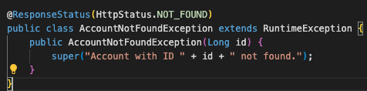
@ExceptionHandler with Custom Exceptions
✔️ This exception clearly represents the case where an account ID doesn’t exist — making failures more meaningful. ✔️ Extending RuntimeException allows reuse across services, while @ResponseStatus automatically returns a 404 response. ✔️ Throwing it from controller or service methods ensures clients receive clean, structured JSON errors without any extra response-handling code.
@CodeByHaindavi | #SpringWithMe

Slide 5
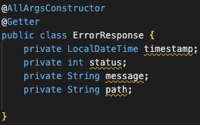
Creating Standardized Error Response Objects
✔️ The ErrorResponse class defines a consistent structure for all error outputs using fields like timestamp, status, message, and path. ✔️ This format keeps client responses predictable and makes debugging easier during development and in production. ✔️ Using Lombok’s @Getter and @AllArgsConstructor keeps the code clean, readable, and free from manual getter/setter clutter.
@CodeByHaindavi | #SpringWithMe

Slide 6
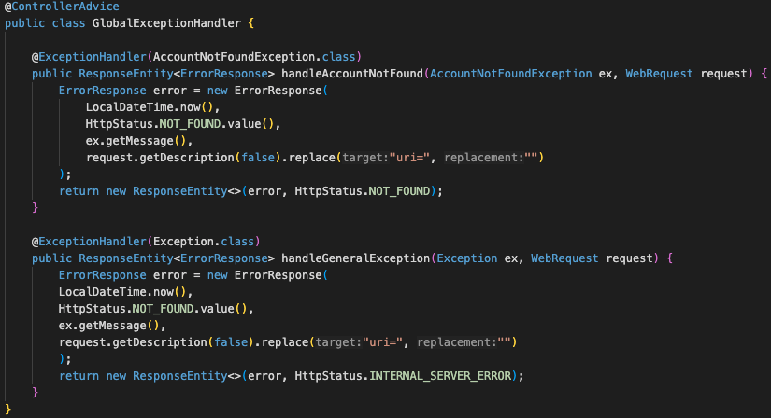
Validation Errors in Spring Boot
✔️ The @ControllerAdvice class handles exceptions across the application, mapping known ones like AccountNotFoundException to clean 404 responses. ✔️ It also catches unexpected errors globally and returns a safe 500 response without leaking internal details. ✔️ This approach avoids repetitive try-catch blocks and keeps error handling consistent across all controllers.
@CodeByHaindavi | #SpringWithMe

Slide 7
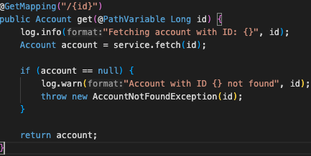
Logging Exceptions in Spring Boot
✔️ Important events like account fetches and failures are logged using SLF4J, helping trace issues without user input. ✔️ Stack traces and technical details are logged internally, while clients receive clean, safe messages through JSON responses. ✔️ Centralizing this logic through @ControllerAdvice ensures all exceptions are logged consistently — without cluttering business code.
@CodeByHaindavi | #SpringWithMe

Slide 8
📌 Hands-On Tip
✔️ Clean exception handling turns backend failures into predictable, safe responses — critical for user trust and API reliability. ✔️ Custom exceptions and centralized @ControllerAdvice keep logic clear, testable, and easy to maintain. ✔️ A standard error response format, combined with validation handling, ensures consistency across the entire API. ✔️ Proper logging captures root causes without exposing internals — the key to debugging and monitoring in production.
👉 Every great backend has one thing in common: it fails gracefully.
@CodeByHaindavi | #SpringWithMe

Slide 9
💼 Interview Insight
What’s included in your standard error response and why?
• Fields like timestamp, status, message, and path provide complete context for both the client and backend logs.
• This structure ensures predictable responses for all errors — from validation to server exceptions — which simplifies debugging and monitoring.
How do you handle validation errors in Spring Boot using @Valid?
• Spring throws MethodArgumentNotValidException when @Valid fails — we catch it globally using @ExceptionHandler.
• Field-level errors are extracted and returned in a structured message (e.g., "email: must not be blank"), improving client-side UX.
@CodeByHaindavi | #SpringWithMe

Slide 10
📌 Recap – Day 8
✔️ All exceptions are handled centrally using @ControllerAdvice, keeping the code clean and consistent. ✔️ Custom exceptions make error messages more meaningful and easier to manage across the application. ✔️ A standard error response format helps clients and developers understand failures quickly. ✔️ Validation errors are caught early using @Valid, and logs capture the rest without exposing sensitive details.
👉 Coming up next: Security with JWT + Roles
@CodeByHaindavi | #SpringWithMe

